Slide 1
Pre-Work
Semiconductor IC Design
Foundation And Readiness Programme

Slide 2
Introduction
Underpinning knowledge and Understanding for SoC design
ASIC flow
Modules, Test and Mini Projects

Slide 3
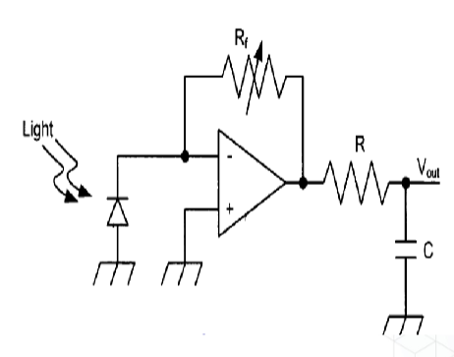
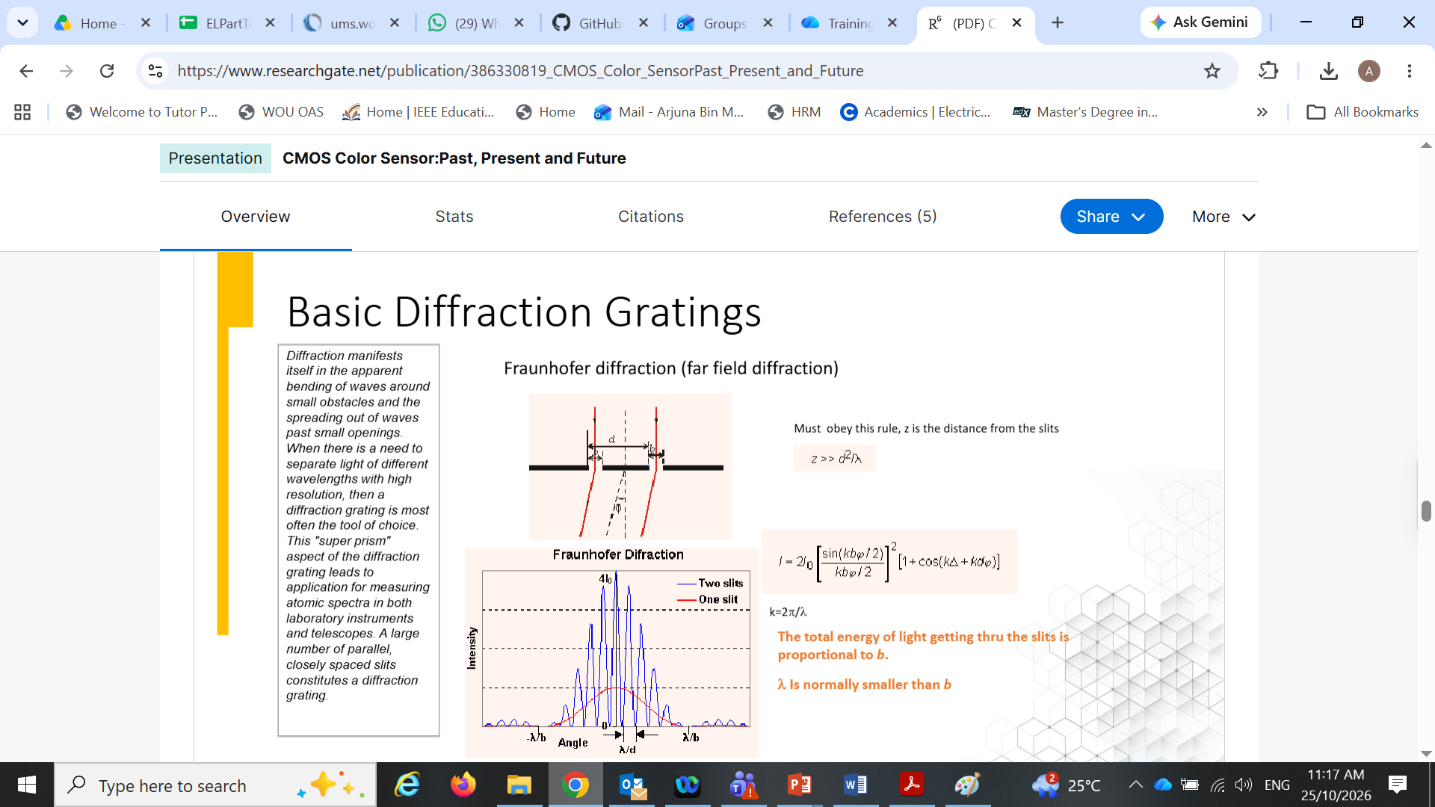
How does it make sense for Science POV
Wave-Particle duality of Light

Slide 4
Design Dimension
Technology
Circuit Topology
Final Design
One can foresee the “novelty” of the final design by knowing the level of the “maturity” of these three factors.
To “commercialize” an integrated circuit as a product, the level of maturity should be high.
The lack of maturity can be considered as research gaps for the researchers.
Methodology
(EDA tools)
Copyright ®CRC PRESS. Permission required for reproduction or display.

Slide 5
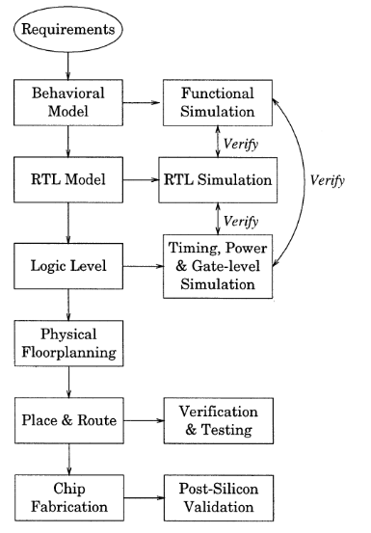
ASIC Flow

Slide 6
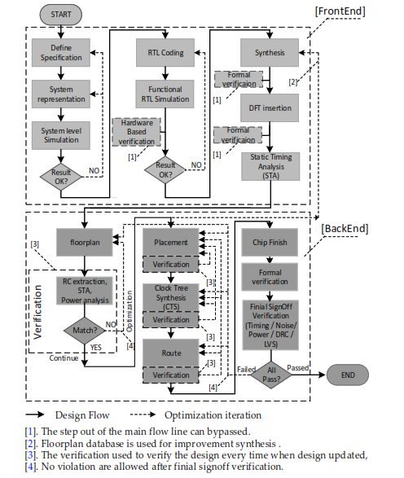
ASIC Flow

Slide 7
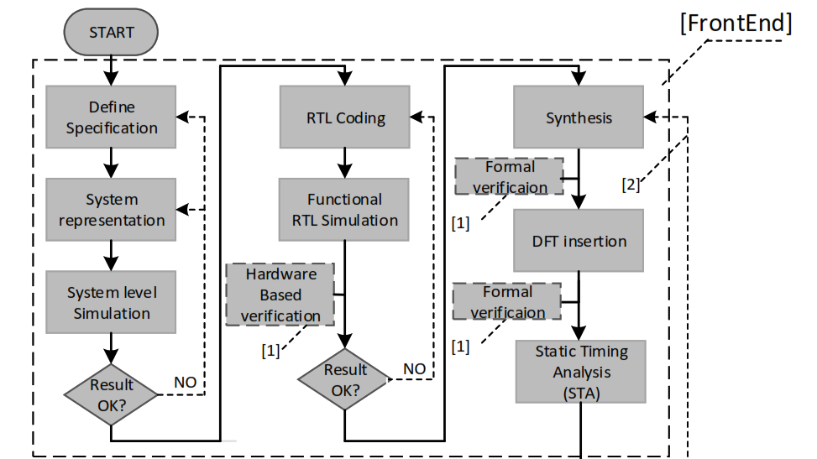
Frontend Flow
Partition the system task into the hardware and the software.
The hardware creates the platform to contain the overall
system, and the software runs on the given platform to
control the system.
Top level simulator (Matlab/Simulink), etc.
hard-core IPs are analog or mixed-circuit–related IP, such as analogue-to-digital converter (ADC), digital-to-analogue converter (DAC), phase lock loop (PLL), and IO pads.
IP Generator for RTL coding
Synthesizable HDL Behaviour to gate level RTL

Slide 8
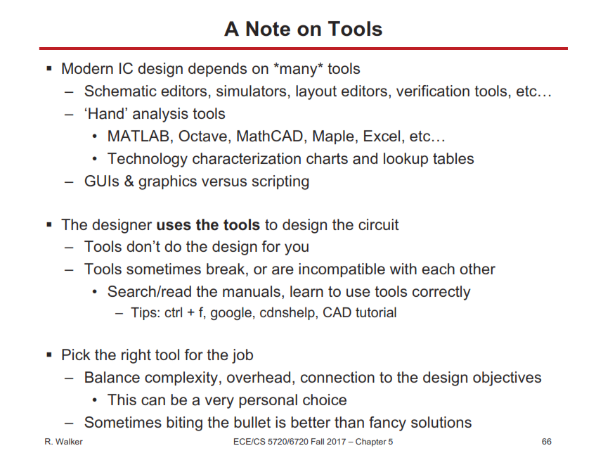
EDA Tools

Slide 9
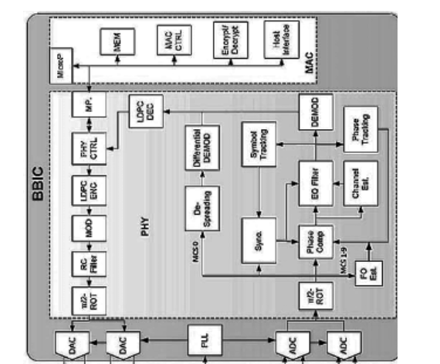
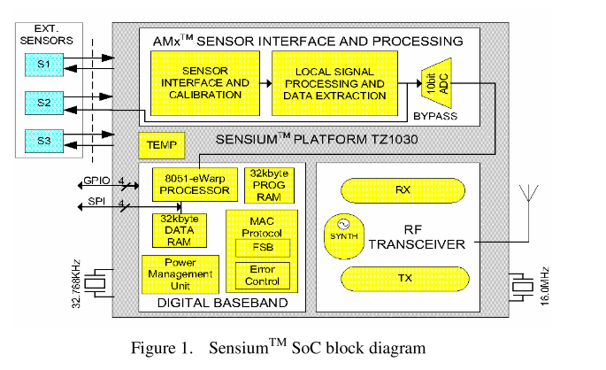
SoC-BBIC for 60 GHz Transceiver
8051 IP?
1 KHz data rate. 900 MHz ISM Band.
two microprocessors are implemented: one to handle MAC and the other to control the PHY. The sequential control program is more suitable to implement using software coding (Hardware accelerator?). Also, for the baseband processor, which needs high-density data processing in parallel, is more suitable to implement using hardware.

Slide 10
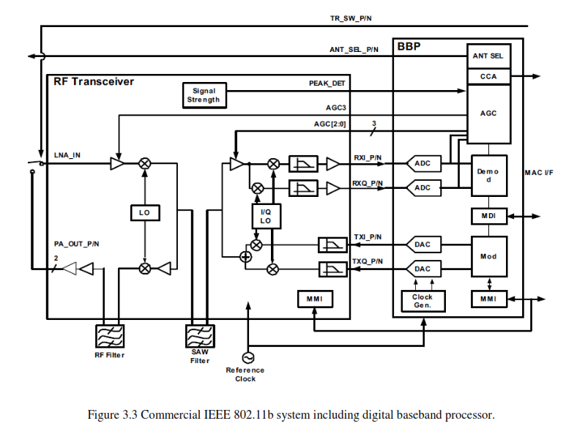
BBP + Transceiver

Slide 11
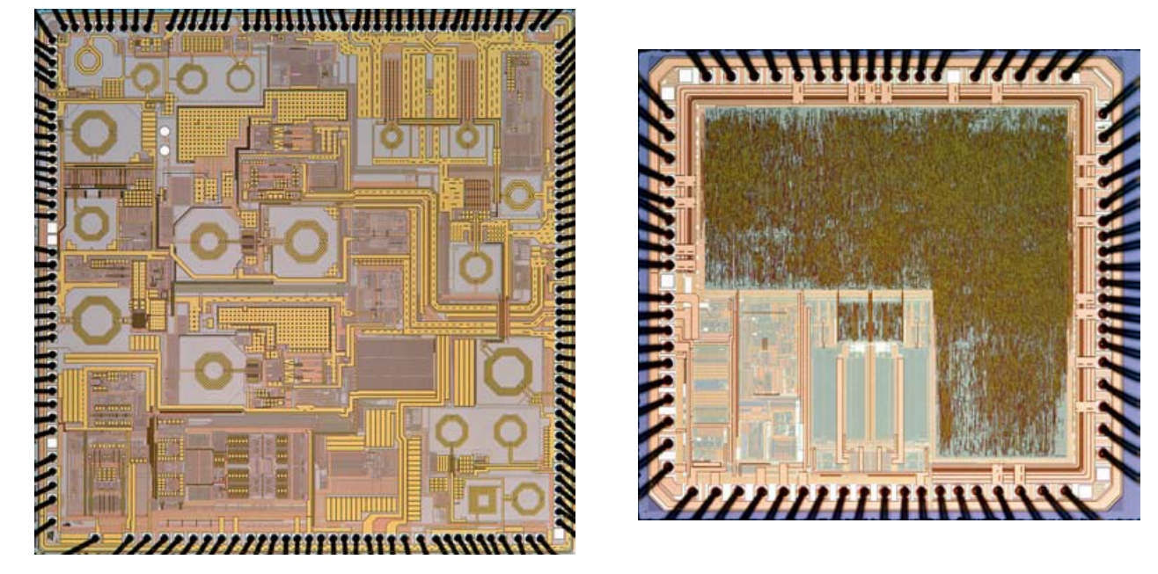
BBP + Transceiver

Slide 12
Modules
Module 1: Review of Programming Concepts and Flows
Module 2: Digital Logic Fundamentals
Module 3: Digital Logic Design
Module 4: MOS Transistor and CMOS Fundamentals
Module 5: Verilog Coding Tutorials
Module 6: Arm On-Demand Pre-Course Preparation

Slide 13
Tests and Mini Projects
Pre-test and Post-Test for each module
Mini-project for each group (5-member team) at the end of module 6. The mini-project should be carried to next training modules.

Slide 14
GitHub
https://github.com/ArjunaMarzuki/Foundation-Pre-Work
Refer to papers or articles for mini-project examples.
Download dsch2 and microwind for mini-projects and other related exercises.

Slide 15
Thank You

